Slide 1
7.3 Linear Systems of Equations. Gauss Elimination

Slide 2
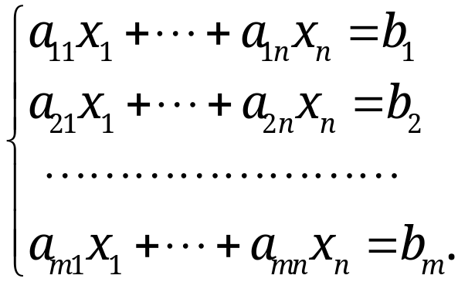
7.3 Linear Systems of Equations. Gauss Elimination
Linear System of Equations
A linear system of m equations in n unknowns x₁, … , x_{n} is a set of equations of the form
(1)
The system is linear – each variable x_{j} appears in the first power only, just as in the equation of a straight line
a₁₁, … , a_{mn} are given numbers, called the coefficients of the system. b₁, … , b_{m} are also given numbers:
  If b₁=b₂=…=b_{m}=0, (1) is called a homogeneous system;
  Otherwise, (1) is called a nonhomogeneous system.
Section 7.3 p<number>

Slide 3
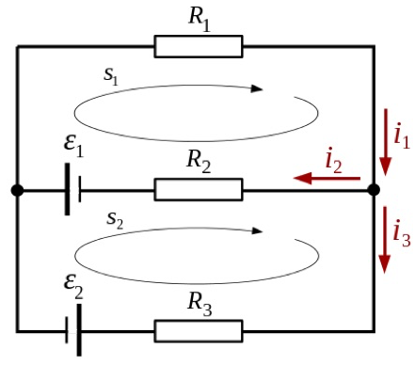
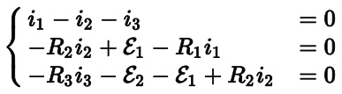
7.3 Linear Systems of Equations. Gauss Elimination
Example: Kirchhoff’s Circuit Laws
At any node in an electrical circuit, the sum of currents flowing into that node is equal to the sum of currents flowing out.
The directed sum of voltage around any closed network is zero.
An electric network has two voltage sources and three resistors.
The above presents an example of (nonhomogeneous) linear system of equations
Section 7.3 p<number>

Slide 4
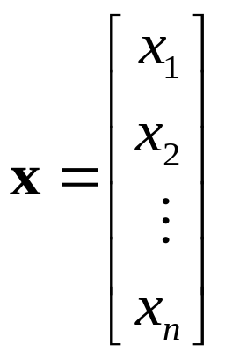
7.3 Linear Systems of Equations. Gauss Elimination
Linear System of Equations (continued)
A solution of (1) is a set of numbers x₁, … , x_{n} that satisfies all the m equations
A solution vector of (1) is a vector x whose components form a solution of (1), i.e.,
If the system (1) is homogeneous, then it always has at least the trivial solution x₁ = 0, … , x_{n} = 0.
Section 7.3 p<number>

Slide 5
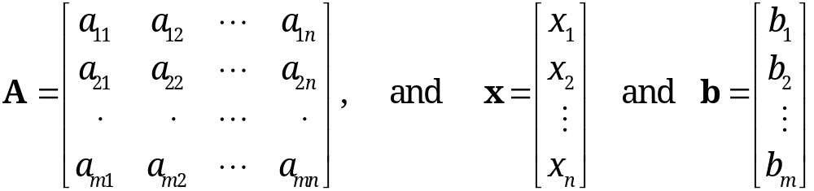
7.3 Linear Systems of Equations. Gauss Elimination
Coefficient and Augmented Matrices
Matrix Form of the Linear System (1)
Using matrix multiplication, the m equations of (1) can be written as a single vector equation
Ax = b
where the coefficient matrix A = [a_{jk}] is the m × n matrix
are column vectors with n and m components, respectively
Section 7.3 p<number>

Slide 6
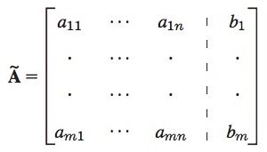
7.3 Linear Systems of Equations. Gauss Elimination
Matrix Form of the Linear System (1) (continued)
Assume the coefficients a_{jk} are not all zero, so that A is not a zero matrix
The matrix
is called the augmented matrix of the system (1)
The dashed vertical line could be omitted -- it is merely a reminder that the last column of Ã comes from vector b. Thus, we augment the matrix A
Note: the augmented matrix Ã determines system (1) completely
Section 7.3 p<number>

Slide 7
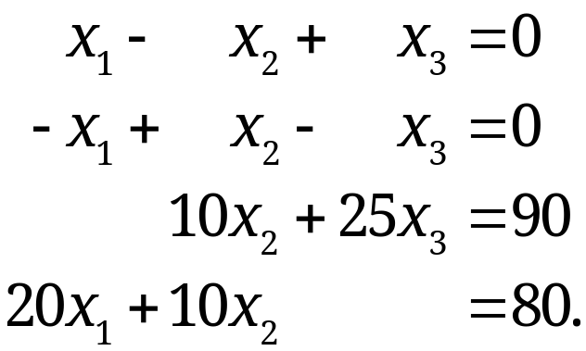
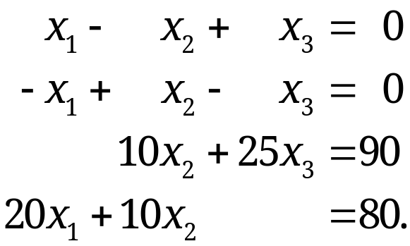
7.3 Linear Systems of Equations. Gauss Elimination
Gauss Elimination and Back Substitution (systematic method for solving linear systems)
Example 1: solve the linear system
Conduct Gauss Elimination
  Step 1. Elimination of x₁
Pivot equation
Eliminate
Section 7.3 p<number>

Slide 8
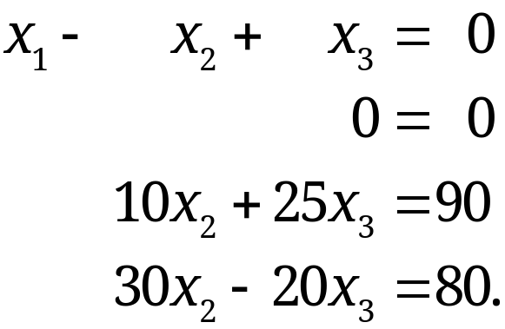
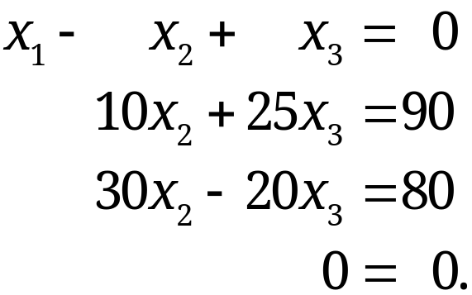


7.3 Linear Systems of Equations. Gauss Elimination
The result is
eq2+eq1
eq4-20×eq1
Step 2. Change equation order (if needed) and elimination of x₂
Section 7.3 p<number>

Slide 9
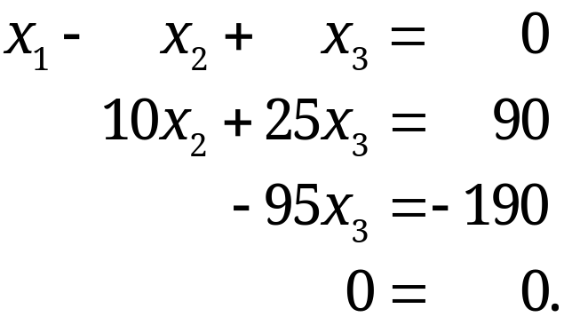
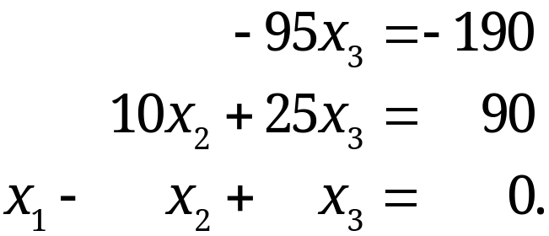
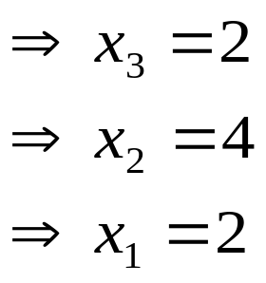
7.3 Linear Systems of Equations. Gauss Elimination
The result is
eq3 - 3×eq2
Conduct back substitution
  Determination of x₃ -> x₂ -> x₁ (in this order)
Section 7.3 p<number>

Slide 10
7.3 Linear Systems of Equations. Gauss Elimination
Gauss Elimination and Back Substitution
The augmented matrix Ã determines the system (1) completely because it contains all the given numbers appearing in (1)
Gauss elimination can be done by considering the augmented matrix Ã
Revisit Example 1: solve the linear system
Section 7.3 p<number>

Slide 11
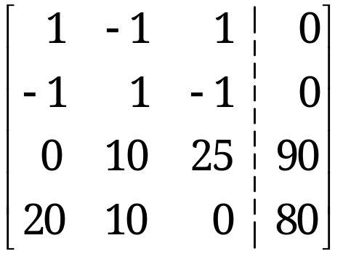
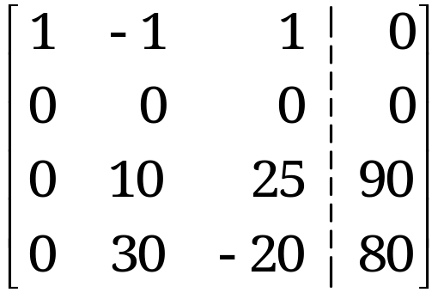

7.3 Linear Systems of Equations. Gauss Elimination
Revisit EXAMPLE 1 Gauss Elimination.
As indicated, let us write the augmented matrix of the system first and then the system itself:
Augmented Matrix Ã Equations
The result is
(3)
Pivot 1
Pivot x₁
Eliminate
Eliminate
Section 7.3 p<number>

Slide 12
7.3 Linear Systems of Equations. Gauss Elimination
Revisit EXAMPLE 1 Gauss Elimination (continued)
Step 1. Elimination of x₁
Call the first row of A the pivot row (as the first equation is the pivot equation)
Call the coefficient 1 of its x₁-term the pivot in this step
Use this equation to eliminate x₁ (get rid of x₁) in the other equations. To do so:
  Add 1 times the pivot equation to the second equation
  Add −20 times the pivot equation to the fourth equation
These correspond to row operations on the augmented matrix as indicated behind the new matrix in (3)
Operations are performed on the preceding matrix
Section 7.3 p<number>

Slide 13
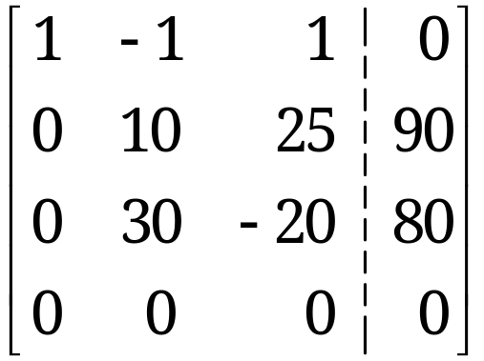




7.3 Linear Systems of Equations. Gauss Elimination
Revisit EXAMPLE 1 Gauss Elimination (continued)
Step 2. Elimination of x₂
The first equation remains as it is
Since the new second equation has no x₂-term, we need to change the order of the equations and the corresponding rows of the new matrix
Put 0 = 0 to the end and move the remaining equations one place up
The result is
Section 7.3 p<number>

Slide 14
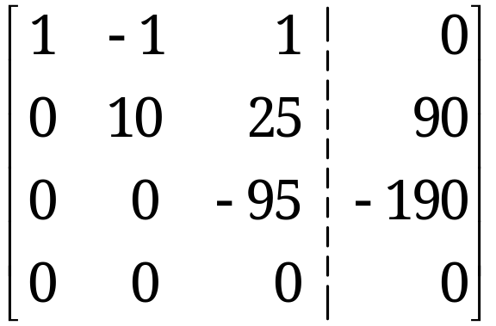

7.3 Linear Systems of Equations. Gauss Elimination
Revisit EXAMPLE 1 Gauss Elimination (continued)
Step 2. Elimination of x₂ (continued)
To eliminate x₂, add (−3) times the pivot equation to the third equation
The result is
(4)
Since further elimination is not possible, Gauss elimination is thus stopped
Section 7.3 p<number>

Slide 15
7.3 Linear Systems of Equations. Gauss Elimination
Revisit EXAMPLE 1 Gauss Elimination (continued)
Back Substitution – determination of x₃, x₂, x₁ (in this order)
Working backward from the last to the first equation of this “triangular” system (4), we can now readily find x₃, then x₂, and then x₁:
This is the solution to our problem, which is unique.
Advantage of Gauss elimination: it is systematic and will work in general, and also for large systems
Section 7.3 p<number>
Notes:
Stop here for first break

Slide 16
7.3 Linear Systems of Equations. Gauss Elimination
Gauss Elimination Involves Only Elementary Row Operations
Elementary Row Operations for Matrices:
Interchange of two rows
Addition of a constant multiple of one row to another row
Multiplication of a row by a nonzero constant c
The above row operations for matrices are equivalent to the following Elementary Row Operations for Equations:
Interchange of two equations
Addition of a constant multiple of one equation to another equation
Multiplication of an equation by a nonzero constant c
Elementary row operations do not alter the solution set!
Section 7.3 p<number>

Slide 17
7.3 Linear Systems of Equations. Gauss Elimination
Row-Equivalent Systems
A linear system S₁ is row-equivalent to another linear system S₂ if S₁ can be obtained from S₂ by (finitely many) row operations
Gauss elimination produces row-equivalent systems
Theorem 1
Row-Equivalent Systems
Row-equivalent linear systems have the same set of solutions
Remarks:
Gauss elimination preserves the solution set
We are dealing with row operations. Column operations on the augmented matrix will generally alter the solution set and are NOT permitted in this context
Section 7.3 p<number>

Slide 18
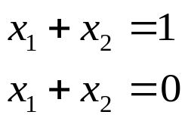
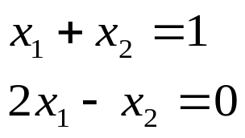
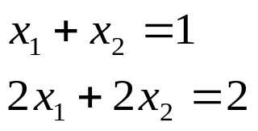
7.3 Linear Systems of Equations. Gauss Elimination
Types of Solutions For Linear Systems
System (1) may be either consistent (with at least one solution) or inconsistent (with no solution at all)
Example 2
2 equations and 2 unknowns
(a) inconsistent
(no solution)
(b) consistent
(unique solution)
(c) consistent
(infinitely many solutions)
Section 7.3 p<number>

Slide 19

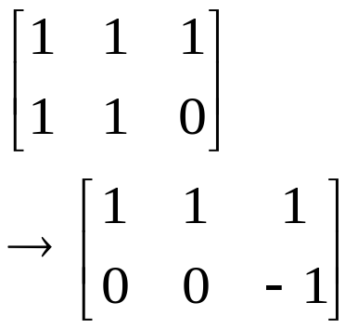
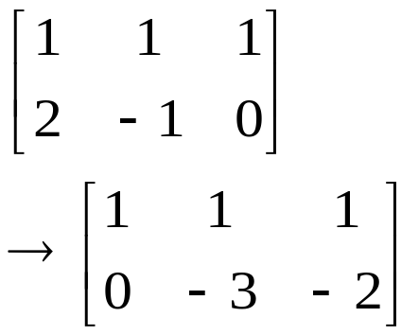
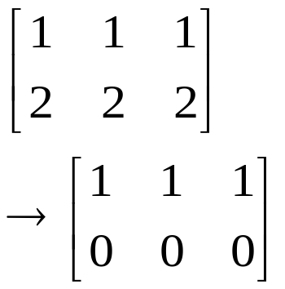
7.3 Linear Systems of Equations. Gauss Elimination
Example 2 (continued)
2 equations and 2 unknowns
Conduct Gauss elimination
Row echelon form
Row echelon form
Row echelon form
(a) inconsistent
(no solution)
(b) consistent
(unique solution)
(c) consistent
(infinitely many solutions)
Section 7.3 p<number>

Slide 20
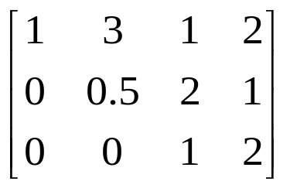
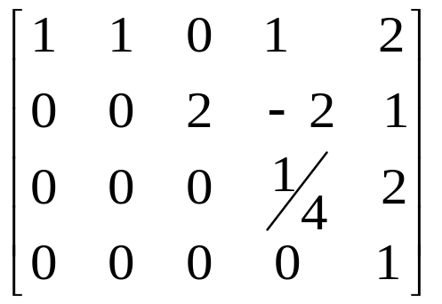
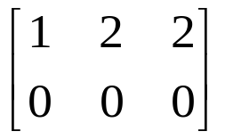
7.3 Linear Systems of Equations. Gauss Elimination
Row Echelon Form
At the end of the Gauss elimination, the form of the coefficient matrix, the augmented matrix, and the system itself are called the row echelon form
Definition
  Rows of zeros, if present, are the last rows
  In each nonzero row, the leftmost nonzero entry is farther to the right than in the previous rows
Examples:
, ,
Note: the leftmost nonzero entries do
not have to be 1 in row echelon form.
Coefficient matrix
Augmented matrix
Section 7.3 p<number>

Slide 21
7.3 Linear Systems of Equations. Gauss Elimination
Row Echelon Form (continued)
The original system of m equations in n unknowns has augmented matrix [A | b].
After Gauss elimination, we convert matrix [A | b] to become matrix [R | f], where both R and [R | f] are in row echelon form.
The two systems Ax = b and Rx = f are equivalent if either one has a solution, so does the other, and the solutions are identical.
Section 7.3 p<number>

Slide 22
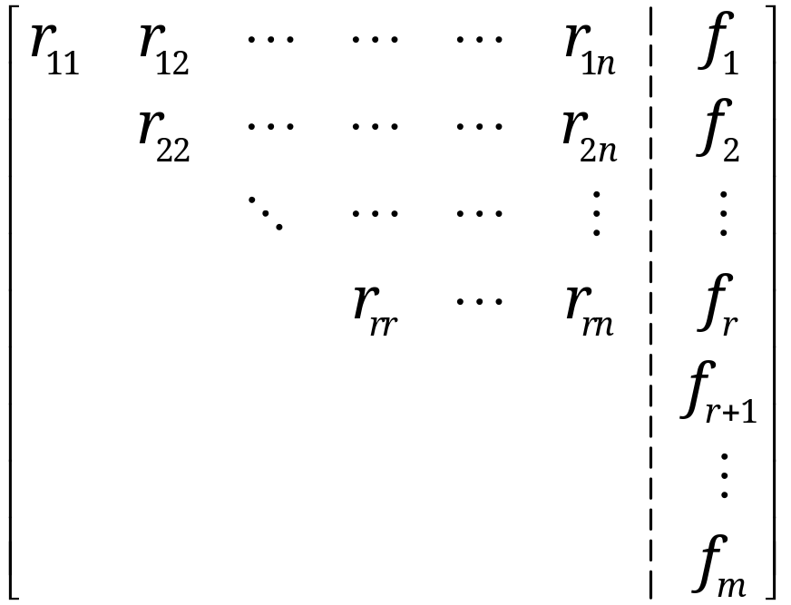
7.3 Linear Systems of Equations. Gauss Elimination
Row Echelon Form and Information on Solution
At the end of Gauss elimination (before back substitution), the row echelon form of the augmented matrix will be
(9)
All entries in the blue triangle and blue rectangle are zero.
Row echelon form
R
F
Section 7.3 p<number>

Slide 23
7.3 Linear Systems of Equations. Gauss Elimination
The number of nonzero rows, r, in the row-reduced coefficient matrix R is called the rank of R and also the rank of A
r may not be the same as m or n. Note that r ≤ m, r ≤ n
The types of solution of Ax = b are determined as:
  Inconsistent (no solution): If r < m (i.e., R has at least one row of all 0s) and at least one of the numbers f_{r+1}, f_{r+2}, … , f_{m} is not zero
  → inconsistency in the equations
  → Rx = f is inconsistent
  → Ax = b is inconsistent
  → No solution!
Section 7.3 p<number>

Slide 24
7.3 Linear Systems of Equations. Gauss Elimination
If r = m (R has no zero row), or
if r < m (R has some zero rows) and all the numbers
f_{r+1}, f_{r+2}, … , f_{m} are zero,
then the system is consistent and there are solutions. In this case, we may have:
  (b) Unique solution. If r = n, there is exactly one solution, which can be found by back substitution. Example 2(b) is one such case, with r=m=n=2 in the row echelon form.
  (c) Infinitely many solutions. If r < n, there are infinitely many solutions. To obtain any of these solutions, choose values of x_{r+1}, … , x_{n} arbitrarily. Then, apply back substitution to solve for x_{r} , x_{r−1}, …., x₁ in terms of those arbitrary values. Example 2(c) is one such case.
Section 7.3 p<number>

Slide 25
7.4 Linear Independence.
Rank of a Matrix. Vector Space

Slide 26
7.4 Linear Independence. Rank of a Matrix. Vector Space
Linear Independence and Dependence of Vectors
Given any set of m vectors a₍₁₎, … , a_{(m)} (of same size), a linear combination of these vectors is of the form
c₁a₍₁₎ + c₂ a₍₂₎ + ∙ ∙ ∙ + c_{m}a_{(m)}
where c₁, c₂, … , c_{m} are any scalars
Consider the equation
(1) c₁a₍₁₎ + c₂ a₍₂₎ + ∙ ∙ ∙ + c_{m}a_{(m)} = 0.
Question: can we find scalars c₁, … , c_{m} such that they are not all zero and equation (1) holds?
  If the answer is “yes”, then the vectors a₍₁₎, … , a_{(m)} are called linearly dependent
  Otherwise, the vectors a₍₁₎, … , a_{(m)} are called linearly independent
Section 7.4 p<number>

Slide 27
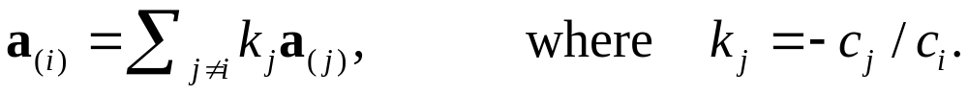
7.4 Linear Independence. Rank of a Matrix. Vector Space
Linear dependence means that at least one of the vectors a₍₁₎, … , a_{(m)} can be expressed as a linear combination of the other vectors
  Suppose that (1) holds for scalars c₁, … , c_{m} with c_{i}≠0, then using (1) we can express a_{(i)} as
In contrast, linear independence means that NONE of the vectors a₍₁₎, … , a_{(m)} can be expressed as a linear combination of the remaining vectors
EXAMPLE 1
Are vectors a₍₁₎, a₍₂₎, and a₍₃₎ linear dependent?
Section 7.4 p<number>

Slide 28
7.4 Linear Independence. Rank of a Matrix. Vector Space
EXAMPLE 1
Are vectors a₍₁₎, a₍₂₎, and a₍₃₎ linear dependent?
Answer:
Yes, a₍₁₎, a₍₂₎, and a₍₃₎ linear dependent because there exists a set of nonzero coefficients, {c_{(i)}}, e.g. {6, 0.5, 1} and we have
6a₍₁₎ – 0.5 a₍₂₎ - a₍₃₎ = 0
Also a₍₁₎ and a₍₂₎ are linear independent because c₍₁₎a₍₁₎ + c₍₂₎a₍₂₎ = 0 implies c₍₂₎ = 0 (examining the 2nd components) and c₍₁₎ = 0 from any component of a₍₁₎
Section 7.4 p<number>

Slide 29
7.4 Linear Independence. Rank of a Matrix. Vector Space
Linear Independence and Dependence of Vectors (continued)
Why is linear independence important?
  If a set of vectors is linear dependent, then we can get rid of one or more of the vectors until we get a linearly independent set of vectors
  A linear independent set of vectors is the smallest “truly essential” set – we cannot express any of the vectors in this set as a linear combination of the remaining vectors
Two simple linearly dependent/independent sets
  A set of vectors that includes zero vector(s) must be linearly dependent
  A set of a single non-zero vector must be linear independent
Section 7.4 p<number>

Slide 30
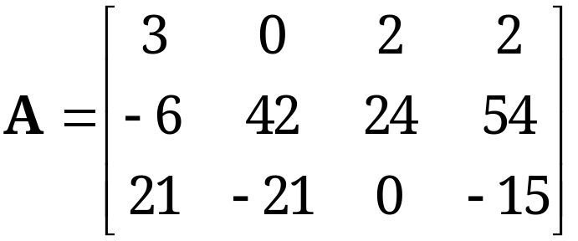
7.4 Linear Independence. Rank of a Matrix. Vector Space
Rank of a Matrix
Definition
The rank of a matrix A, denoted by rank A, is the maximum number of linearly independent row vectors of A.
Note: rank A = 0 if and only if A = 0.
EXAMPLE 2 Rank
What is the rank of the matrix A?
Solution: rank A = 2
Section 7.4 p<number>

Slide 31
7.4 Linear Independence. Rank of a Matrix. Vector Space
Theorem 1
Row-Equivalent Matrices
Row-equivalent matrices have the same rank.
Remark:
  A matrix A₁ is row-equivalent to another matrix A₂ if A₁ can be obtained from A₂ by (finitely many) elementary row operations
  Elementary row operations do not change the rank
  Thus, the rank of a matrix is invariant under elementary row operations (or Gauss elimination)
Section 7.4 p<number>

Slide 32
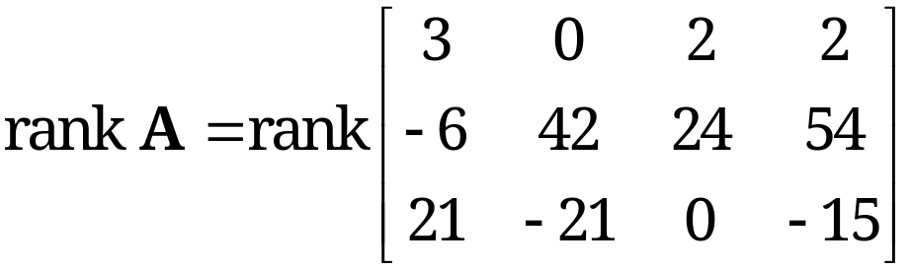
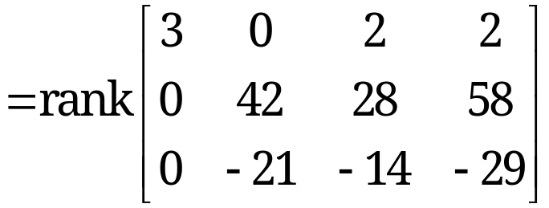
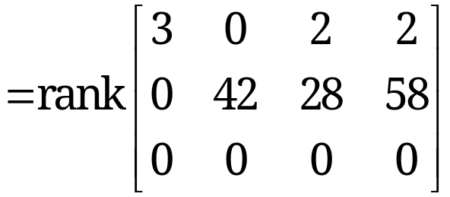
7.4 Linear Independence. Rank of a Matrix. Vector Space
Determination of Rank
From Theorem 1, we can determine the rank of a matrix by reducing it to the row-echelon form and count the number of nonzero rows
EXAMPLE 3 Determine rank A in Example 2
Thus, rank A = 2.
Section 7.4 p<number>

Slide 33
7.4 Linear Independence. Rank of a Matrix. Vector Space
Theorem 2
Linear Independence and Dependence of Vectors
To determine the linear dependency or independency of a set of vectors, we can put them as rows of a matrix and determine the rank of the resulting matrix
Specifically, consider p vectors each of which has n components
  If the matrix formed with these vectors as row vectors has rank p, then these vectors are linearly independent
  If the matrix formed has rank less than p, then these vectors are linearly dependent
Section 7.4 p<number>

Slide 34
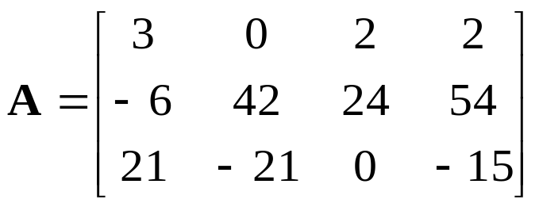
7.4 Linear Independence. Rank of a Matrix. Vector Space
Theorem 3
Rank in Terms of Column Vectors
The rank r of a matrix A equals the maximum number of linearly independent column vectors of A
Hence, rank A = rank A^{T}
EXAMPLE 4 Verification of Theorem 3
Verify for the following matrix that rank A = rank A^{T}
Section 7.4 p<number>

Slide 35
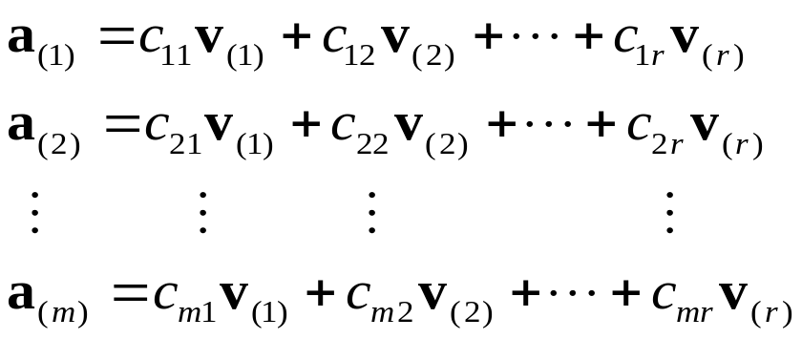

7.4 Linear Independence. Rank of a Matrix. Vector Space
Proof of Theorem 3
Suppose rank A = r. Since A=(A^{T})^{T}, we only need to prove rank A^{T} ≤ r for any matrix A. (but why?)
By definition of rank, matrix A has r linearly independent row vectors, denoted by v₍₁₎, ∙ ∙ ∙, v_{(r)}, and all the row vectors are linear combinations of those, say
(3)
From (3), what is a₁₁?
Section 7.4 p<number>

Slide 36

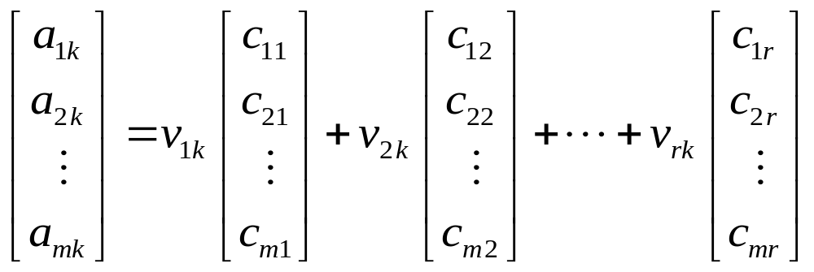
7.4 Linear Independence. Rank of a Matrix. Vector Space
Proof of Theorem 3 (continued)
What is a_{jk}, with j=1, ∙ ∙ ∙, m, k=1, ∙ ∙ ∙, n?
(4)
The kth column of matrix A can be expressed as
(5)
Thus, each column vector of A is a linear combination of the same r column vectors on the RHS of (5)
This shows rank A^{T} ≤ r; if this is true in general then rank (A^{T})^{T} <= r, but rank A = r, so we must have rank A^{T} = r
Section 7.4 p<number>

Slide 37
7.4 Linear Independence. Rank of a Matrix. Vector Space
Theorem 4
Linear Dependence of Vectors
Consider p vectors each having n components. If n < p, then these vectors are linearly dependent.
Section 7.4 p<number>

Slide 38
7.4 Linear Independence. Rank of a Matrix. Vector Space
Vector Space
Consider a nonempty set V of vectors (of same size). V is called a vector space if the following 1) – 3) are satisfied:
For any two vectors a and b in V, all their linear combinations αa + βb (where α, β are any real numbers) are also in V;
Addition between vectors a, b, c in V satisfies
  a + b = b + a (commutative rule)
  (a + b) + c = a + (b + c) (associative rule)
  a + 0 = a (Existence of 0 vector)
  a + (-a) = 0 (Existence of (-a) vector)
Scalar multiplication of vectors a, b in V satisfies
  c(a + b) = ca + cb c and k are any real numbers
  (c+k)a = ca + ka
  c(ka) = (ck)a
  1a = a
Section 7.4 p<number>

Slide 39
7.4 Linear Independence. Rank of a Matrix. Vector Space
Dimension and Basis
The maximum number of linearly independent vectors in V is called the dimension of V and is denoted by dim V
A linearly independent set in V consisting of a maximum possible number of vectors in V is called a basis for V
  Any largest possible set of linearly independent vectors in V forms basis for V
  If we add one or more vectors to the basis, then it will become linearly dependent.
  Any vector in V can be expressed as a linear combination of a basis in V.
The number of vectors of a basis for V equals dim V
Section 7.4 p<number>

Slide 40
7.4 Linear Independence. Rank of a Matrix. Vector Space
Span of a Vector Set
The set of all linear combinations of given vectors a₍₁₎,…, a_{(p)} (of same size) is called the span of these vectors
A span is a vector space (as a set of same size vectors)
If additionally, the given vectors a₍₁₎, … , a_{(p)} are linearly independent, then they form a basis for the spanned vector space
Another Equivalent Definition of Basis
A set of vectors is a basis for vector space V if
the vectors in the set are linearly independent; and
any vector in V can be expressed as a linear combination of the vectors in the set. In 2) holds, we say that the set of vectors spans the vector space V
Section 7.4 p<number>

Slide 41
7.4 Linear Independence. Rank of a Matrix. Vector Space
EXAMPLE 5 Vector Space, Dimension, Basis
Are the following V₁ and V₂ vector spaces?
Given the following three vectors
  What is the vector space V₃ spanned by a₍₁₎, a₍₂₎, and a₍₃₎?
  Find the dimension and a basis of V₃
Section 7.4 p<number>

Slide 42
7.4 Linear Independence. Rank of a Matrix. Vector Space
Solution
Are V₁ and V₂ vector spaces?
  V₁ is a vector space, while V₂ is NOT
What is the vector space V₃ spanned by a₍₁₎, a₍₂₎, and a₍₃₎?
Find the dimension and a basis of V₃
  dim V₃ = 2
  A basis of V₃ is given by {a₍₁₎, a₍₂₎}
  Recall we showed previously that a₍₁₎ and a₍₂₎ are linearly independent and a₍₁₎, a₍₂₎ and a₍₃₎ are linearly dependent.
Section 7.4 p<number>

Slide 43
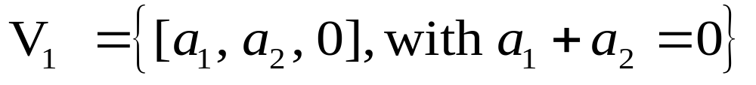
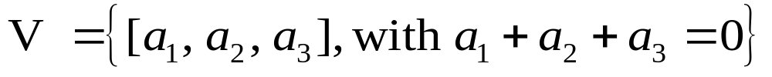
7.4 Linear Independence. Rank of a Matrix. Vector Space
Subspace of a Vector Space
A subspace of a vector space V is a nonempty subset of V that forms a vector space with respect to the two algebraic operations (i.e., vector addition and scalar multiplication) defined for the vectors of V
Example
The vector space
is a subspace of the vector space
Section 7.4 p<number>

Slide 44
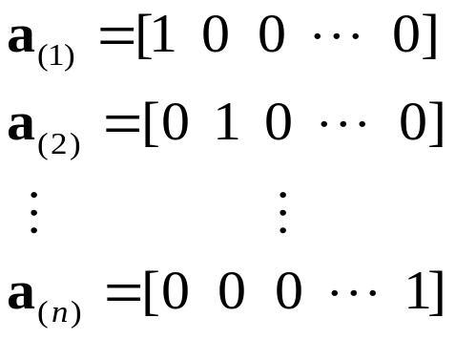
7.4 Linear Independence. Rank of a Matrix. Vector Space
Theorem 5
Vector Space R^{n}
The set consisting of all vectors with n components (n real numbers) is a vector space, has dimension n, and is denoted by space R^{n}
Proof
The said set is the vector space spanned by a basis of n linearly independent vectors
Section 7.4 p<number>

Slide 45
7.4 Linear Independence. Rank of a Matrix. Vector Space
Given a matrix A,
  The row space of A is the vector space spanned by the row vectors of A
  The column space of A is the vector space spanned by the column vectors of A
Since rank A = rank A^{T}, the maximum numbers of linearly independent row and column vectors are the same
Theorem 6
Row Space and Column Space
The row space and the column space of any matrix A have the same dimension, both equal to rank A
Section 7.4 p<number>

Slide 46
7.4 Linear Independence. Rank of a Matrix. Vector Space
Null Space
For any given matrix A, the solution set of the homogenous system Ax = 0 is a vector space, called the null space of A
The dimension of the null space of A is called the nullity of A
In Section 7.5, we will prove the basic relation
(6) rank A + nullity A = Number of columns of A
Section 7.4 p<number>

